Slide 1


Department of CSE
COMPUTER NETWORKS
24CS2202
Topic:
Network hardware
Session - 2

Slide 2



AIM OF THE SESSION
To familiarize students with the network topologies and different types of computer networks
INSTRUCTIONAL OBJECTIVES
This Session is designed to:
Demonstrate the network topologies
Describe different types of networks based on transmission technology and scale.
Describe the modes of data transmission.
LEARNING OUTCOMES
At the end of this session, you should be able to:
Define topology and describe the way how systems are connected using different topologies.
Illustrate different types of networks based on transmission technology used and on geographical area.
Summarize the modes of data transmission.

Slide 3
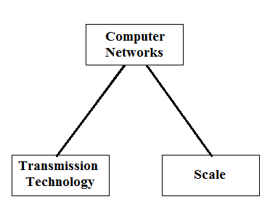
SESSION INTRODUCTION
Network Hardware:
Deals with technical issues involved in network design.
Two dimensions:
  Transmission technology
  Scale.
A Computer Network consists of a collection of computers, printers and other equipment that is connected together so that they can communicate with
each other

Slide 4
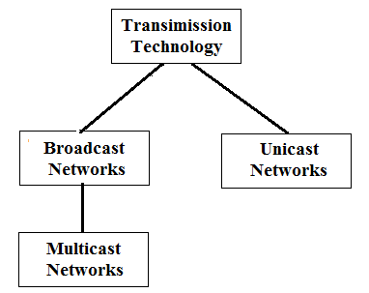
Transmission is actually the process of sending and propagating signals of digital information.
Transmission technology generally refers to physical layer protocol duties like modulation, demodulation, line coding, etc.
TRANSMISSION TECHNOLOGY

Slide 5
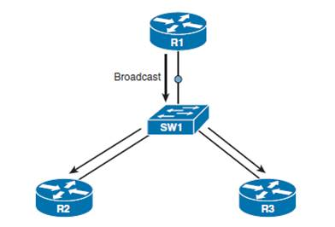
Transmission Technology…
Broadcast Networks:
Have single communication channel that is shared by all the machines on the network.
Short messages(Packets) sent by any machine are received by all the others.
An address field within the packet specifies the intended recipient.
Upon receiving a packet, a machine checks the address field.
If the packet is intended for the receiving machine, that machine processes the packet.
If the packet is intended for some other machine, it is just ignored.

Slide 6
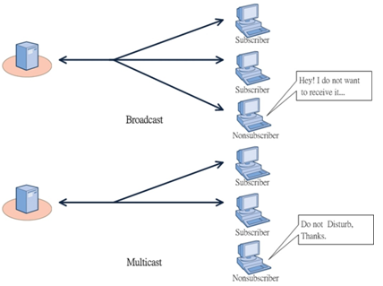
Transmission Technology…
Multicast Networks:
Some broadcast systems also support transmission to a subset of the machines, known as multicasting.
One possible scheme is to reserve one bit to indicate multicasting. The remaining n-1 address bits can hold a group number.
When a packet is sent to a certain group, it is delivered to all machines subscribing to that group.

Slide 7

Transmission Technology…
Point-to-Point Networks:
Point-to-point networks consist of many connections between individual pairs of machines.
Often multiple routes, of different lengths, are possible, so finding good ones is important in point-to-point networks.
Usually, smaller geographically localized networks tend to use broadcasting, whereas larger networks usually are point-to-point.
Point-to-point transmission with one sender and one receiver is sometimes called Unicasting.

Slide 8
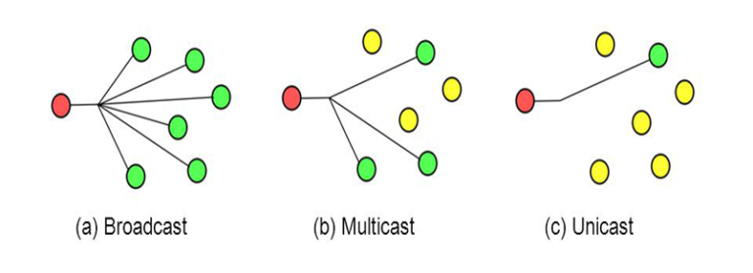
Transmission Technology…

Slide 9
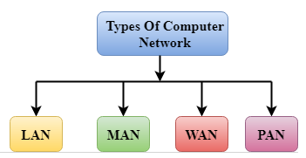
COMPUTER NETWORKS BASED ON SCALE
A computer network can be categorized by their size.
Four types:
  PAN(Personal Area Network)
  LAN(Local Area Network)
  MAN(Metropolitan Area Network)
  WAN(Wide Area Network)

Slide 10
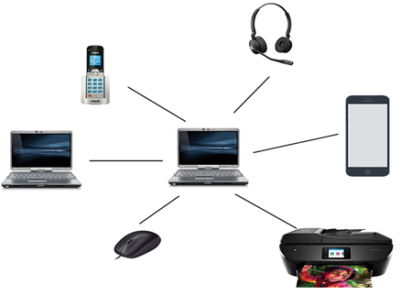
PAN (Personal Area Network)
Personal Area Network is a network arranged within an individual person, typically within a range of 1 to 10 meters.
PAN is used for connecting the computer devices of personal use.
Personal computer devices that are used to develop the personal area network are the laptop, mobile phones, media player and play stations.
There are two types of Personal Area Network:
  Wired Personal Area Network (USB)
  Wireless Personal Area Network (Wifi, Bluetooth, etc)

Slide 11
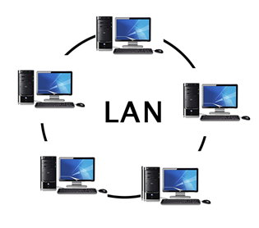
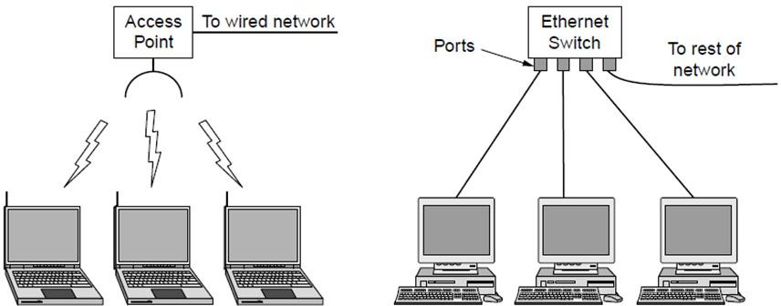
LAN (Local Area Network)
Local Area Network is a group of computers connected to each other in a small area such as building, office.
LAN is used for connecting two or more personal computers through a communication medium such as twisted pair, coaxial cable, etc.
It is less costly as it is built with inexpensive hardware such as hubs, network adapters, and ethernet cables.
The data is transferred at an extremely faster rate in Local Area Network.
Local Area Network provides higher security

Slide 12
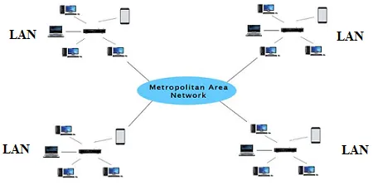
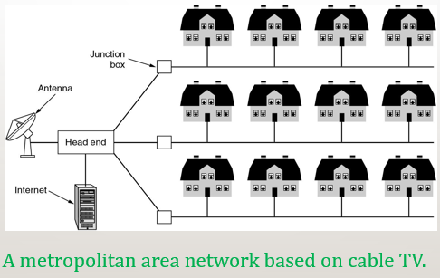
MAN (Metropolitan Area Network)
A metropolitan area network is a network that covers a larger geographic area by interconnecting different LANs to form a larger network.
In MAN, various LANs are connected to each other through a telephone exchange line.
Government agencies use MAN to connect to the citizens and private industries.
It has a higher range than Local Area Network(LAN).
Uses of MAN:
Used in communication between the banks in a city.
It can be used in an Airline Reservation.
It can be used in a college within a city.
It can also be used for communication in the military.

Slide 13
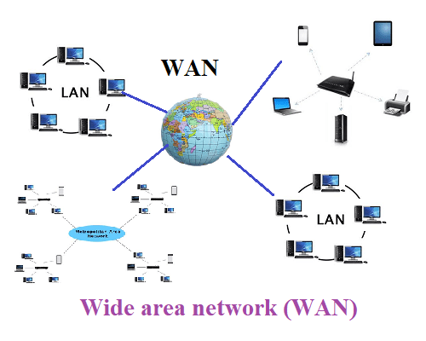
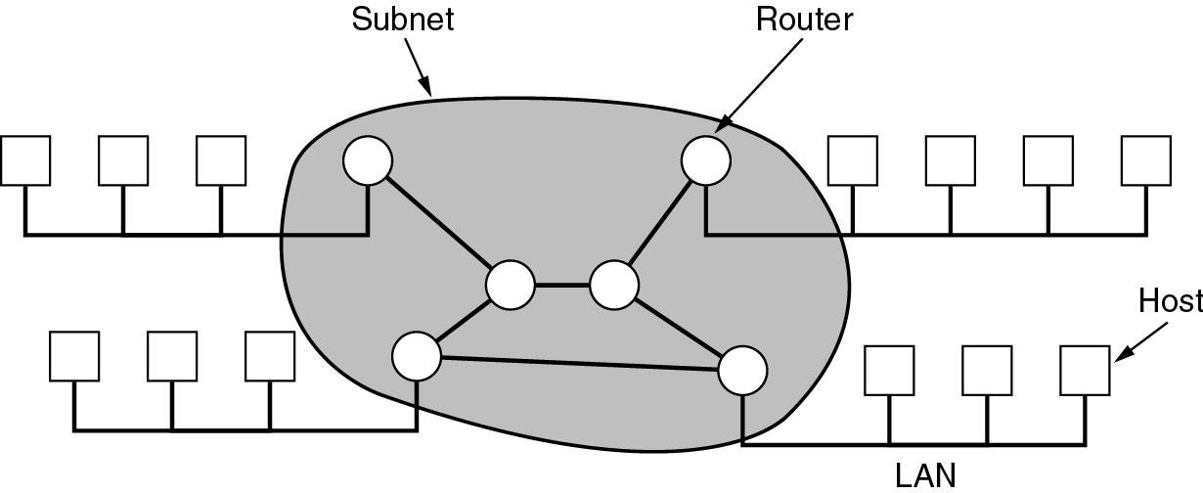
WAN (Wide Area Network)
A Wide Area Network is a network that extends over a large geographical area such as states or countries.
A Wide Area Network is quite bigger network than the LAN and MAN.
WAN is not limited to a single location, but it spans over a large geographical area through a telephone line, fibre optic cable or satellite links.
WAN is widely used in the field of Business, government, and education.

Slide 14
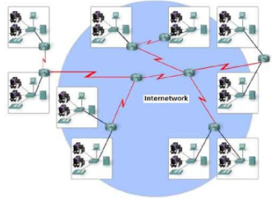
Internetwork / Internet
LANs and WANs may be interconnected into an internetwork – a global mesh of interconnected computer networks.
An interconnection between public, private, commercial, industrial, or government computer networks can also be defined as internetworking.
An internetworking uses the internet protocol.
The reference model used for internetworking is Open System Interconnection(OSI).

Slide 15
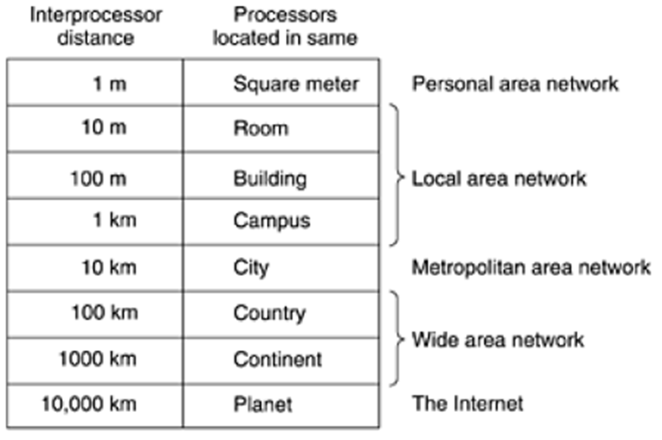

Slide 16
SELF-ASSESSMENT QUESTIONS
1. Two or more computers connected close together in a local area e.g. building or office is called?
PAN
LAN
MAN
WAN
2. Which of the following shows the correct arrangement of networks from the smallest to the largest network?
WAN, LAN, MAN
LAN, MAN, WAN
WAN, MAN, LAN
LAN, WAN, MAN
3. What is the purpose of a WAN?
To allow computers to communicate with each other in the same area
To allow computers to communicate with each other - anywhere in the world

Slide 17
SELF-ASSESSMENT QUESTIONS: Answers
1. Two or more computers connected close together in a local area e.g. building or office is called?
PAN
MAN
LAN
WAN
2. Which of the following shows the correct arrangement of networks from the smallest to the largest network?
WAN, LAN, MAN
LAN, MAN, WAN
WAN, MAN, LAN
LAN, WAN, MAN
3. What is the purpose of a WAN?
To allow computers to communicate with each other in the same area
To allow computers to communicate with each other - anywhere in the world

Slide 18

Topic Summary
Network types based on Technology
Network types based on Geographical Scale

Slide 19
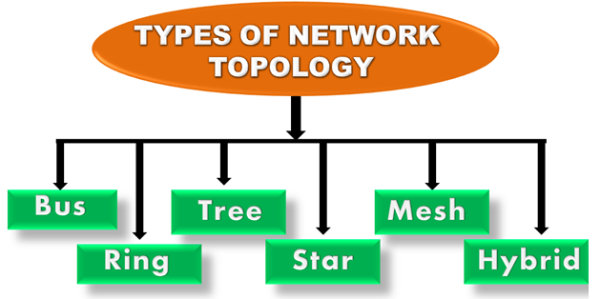
NETWORK TOPOLOGY
Topology defines the structure of the network of how all the components are interconnected to each other.

Slide 20
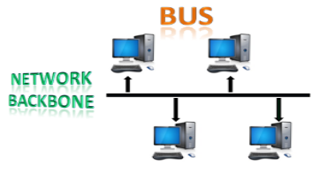
Network Topology..
Bus Topology:
The bus topology is designed in such a way that all the stations are connected through a single cable known as a backbone cable. The backbone cable is considered as a "single lane" through which the message is broadcast to all the stations.
When a node wants to send a message over the network, it puts a message over the network. All the stations available in the network will receive the message whether it has been addressed or not.

Slide 21
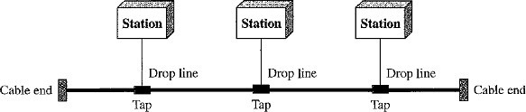
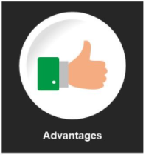
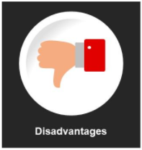
Nodes are connected to the bus cable by drop lines and taps.
A drop line is a connection running between the device and the main cable.
A tap is a connector that splices into (attached to) the main cable.
If the backbone cable fails, the entire system fails.
There is a limit on the number of taps a bus can support and on the distance between those taps.
More taps will generate more heat which degrades the quality of signal.
Installation is easy.
A bus uses less cabling than mesh or star topologies.

Slide 22
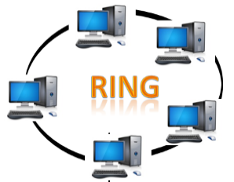
Network Topology..
Ring Topology:
Ring topology is like a bus topology, but with connected ends.
In a ring topology, each device has a dedicated point-to-point connection with only the two devices on either side of it.
The node that receives the message from the previous computer will retransmit to the next node.
A signal is passed along the ring in one direction(clockwise) from device to device, until it reaches its destination.

Slide 23
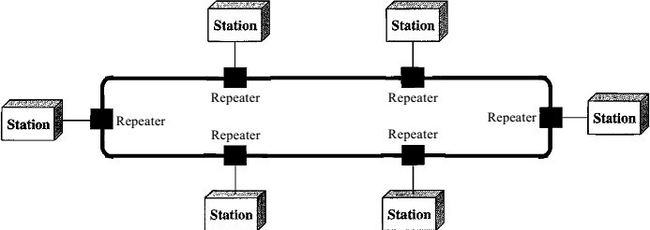
Each device in the ring incorporates a repeater.
When a device receives a signal intended for another device, its repeater regenerates the bits and passes them along.
Easy to install and reconfigure.
To add or delete a device requires changing only two connection.
Unidirectional traffic can be a disadvantage.
A break in the ring (disabled station) can disable the entire network.

Slide 24
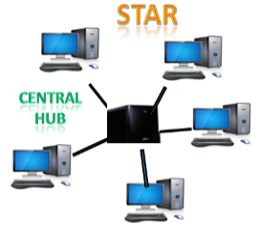
Network Topology..
Star Topology:
Star topology is the most popular topology in network implementation.
The devices are not directly linked to one another.
Star topology is an arrangement of the network in which each device has a dedicated point-to-point link only to a central controller called a Hub or Switch.

Slide 25
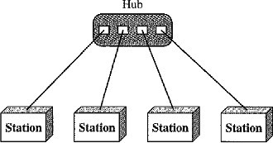
A star topology does not allow direct traffic between devices.
The central controller acts as an exchange.
Easy to install and reconfigure.
Less cabling is required
Star topology is robust, If one link fails, only that link is affected. All other links remain active.
If hub fails entire processing will be stopped working.

Slide 26
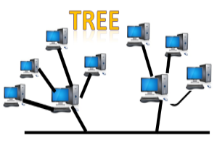
Network Topology..
Tree Topology:
Tree topology combines the characteristics of bus topology and star topology.
All the computers are connected with each other in hierarchical fashion.
The top-most node in tree topology is known as a root node, and all other nodes are the descendants of the root node.
There is only one path exists between two nodes for the data transmission. Thus, it forms a parent-child hierarchy.
Drawback:
Failure: A tree topology mainly relies on main bus cable and failure in main bus cable will damage the overall network.
Reconfiguration difficult: If new devices are added, then it becomes difficult to reconfigure.

Slide 27
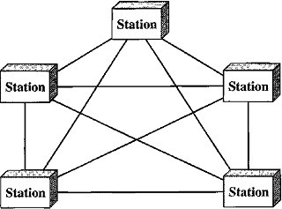
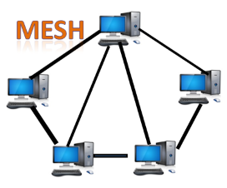
Network Topology..
Mesh Topology:
In a mesh topology, every device has a dedicated Point-to-Point link to every other device. (i.e.) for each node there is a link to all other nodes.
It does not contain the switch, hub or any central computer which acts as a central point of communication.
Mesh topology is mainly used for wireless networks and Internet is an example of the mesh topology.
Mesh topology is mainly used for WAN implementations where communication failures are a critical concern.
Mesh topology can be formed by using the formula:
Number of cables = (n*(n-1))/2.
Types:
Full Mesh Topology
Partial Mesh Topology

Slide 28
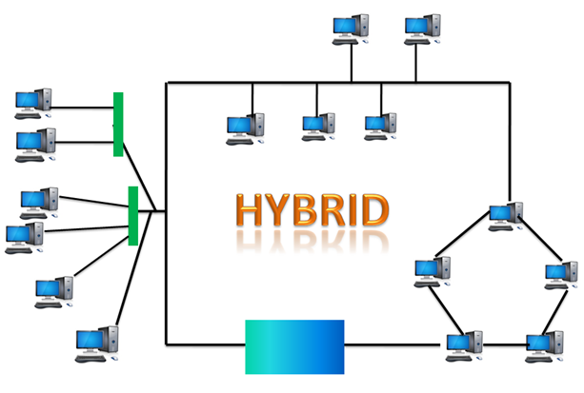
Network Topology..
Hybrid Topology:
The combination of various topologies is known as Hybrid topology.
When two or more different topologies are combined together is termed as Hybrid topology and if similar topologies are connected with each other will not result in Hybrid topology.
Example: if there exist a ring topology in one branch of ICICI bank and bus topology in another branch of ICICI bank, connecting these two topologies will result in Hybrid topology.
Drawbacks:
Complex Design
Costly Hub
Costly Infrastructure

Slide 29
SELF-ASSESSMENT QUESTIONS
Physical or logical arrangement of network is __________
Topology
Routing
Networking
Control
Which network topology requires a central controller or hub?
Star
Mesh
Ring
Mesh
3. A network comprising o multiple topologies is?
Complex
Hybrid
Bus
Star

Slide 30
SELF-ASSESSMENT QUESTIONS - Answers
Physical or logical arrangement of network is __________
Topology
Routing
Networking
Control
Which network topology requires a central controller or hub?
Star
Mesh
Ring
Mesh
3. A network comprising o multiple topologies is?
Complex
Hybrid
Bus
Star

Slide 31
Topic Summary
Network Topologies
  Bus
  Ring
  Star
  Tree
  Mesh
  Hybrid

Slide 32
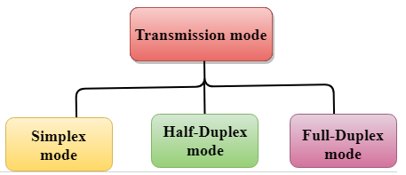
TRANSMISSION MODES
The way in which data is transmitted from one device to another device is known as Transmission mode.
Also called as Communication mode/Direction mode.
Transmission mode is defined in physical layer.

Slide 33

Transmission Modes..
Simplex Mode
In Simplex mode, the communication is unidirectional, i.e., the data flow in one direction.
A device can only send the data but cannot receive it or it can receive the data but cannot send the data.
Keyboard and Monitor are the examples of the simplex mode.

Slide 34
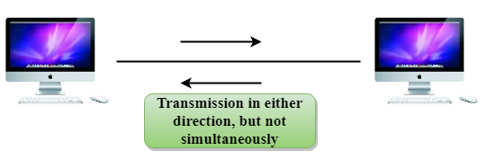
Transmission Modes..
Half-Duplex Mode
In a Half-duplex channel, direction can be reversed, i.e., the station can transmit and receive the data as well.
Messages flow in both the directions, but not at the same time.
A Walkie-talkie is an example of the Half-duplex mode. In Walkie-talkie, one party speaks, and another party listens. After a pause, the other speaks and first party listens. Speaking simultaneously will create the distorted sound which cannot be understood.

Slide 35
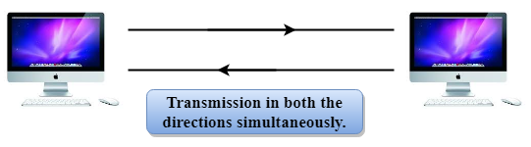
Transmission Modes..
Full-Duplex Mode
In Full duplex mode, the communication is bi-directional, i.e., the data flow in both the directions.
Both the stations can send and receive the message simultaneously.
Full-duplex mode has two simplex channels. One channel has traffic moving in one direction, and another channel has traffic flowing in the opposite direction.
The Full-duplex mode is the fastest mode of communication between devices.

Slide 36
Test your knowledge
WAN stands for __________ | a. World area network
 | b. Wide area network
 | c. Web area network
 | d. Web access network
Which topology uses a single cable which connects all the including nodes? | a. Star
 | b. Mesh
 | c. Ring
 | d. Bus
A term that defines the direction of flow of information between devices. | a. interconnectivity
 | b. intra connectivity
 | c. transmission mode
 | d. Communication

Slide 37
Test your knowledge…
WAN stands for __________ | a. World area network
 | b. Wide area network
 | c. Web area network
 | d. Web access network
Which topology uses a single cable that connects all the including nodes? | a. Hybrid
 | b. Mesh
 | c. Ring
 | d. Bus
A term that defines the direction of flow of information between devices is? | a. interconnectivity
 | b. intra connectivity
 | c. transmission mode
 | d. Communication

Slide 38
SUMMARY
Network Hardware Concepts
  Transmission technology
  Network types based on Geographical Area
  Network Topologies
  Transmission modes

Slide 39
TERMINAL QUESTIONS
1. Describe the network types based on transmission technology.
2. Describe the network types based on their scale.
3. Illustrate different types of network topologies
4. Summarize the modes of data transmission.

Slide 40
REFERENCES FOR FURTHER LEARNING OF THE SESSION
Reference Books:
A.S. Tanenbaum, David J. Wetheral “Computer Networks” Pearson, 5th Edition.
Kurose, J and Ross, K Computer Networking: A Top-Down Approach Addison-Wesley- 6th edition.
Sites and Web links:
https://www.geeksforgeeks.org/types-of-transmission-technology/
https://www.tutorialspoint.com/data_communication_computer_network/computer_network_topologies.htm
3. https://www.javatpoint.com/computer-network-transmission-modes

Slide 41
THANK YOU

